Slide 1
FOOTBALL TRANSFER MARKET ANALYSIS
- Anirudh V RAGAM
NISHANT TRIPATHY
AYUSH AGRAWAL

Slide 2
INTRODUCTION

Slide 3
The transfer market involves players moving from one team to another. This might happen for several reasons, whether it’s the player’s decision to leave the team, or whether the team decides to sell the player.
Our IDS project involves analyzing and studying the trends and changes in the football transfer market .

Slide 4
DATASET
Our dataset contains 3330 rows and 10 column(excluding index).
The data set contains the top 250 transfers of the season from the 2005-06 season to the 2018-19 season
The various columns in our dataset are :-
Name
Position
Age
Team from
League from
Team to
League to
Season
Market Value
Transfer Fee
We came across this dataset on www.Kaggle.com

Slide 5
DATA CLEANING

Slide 6
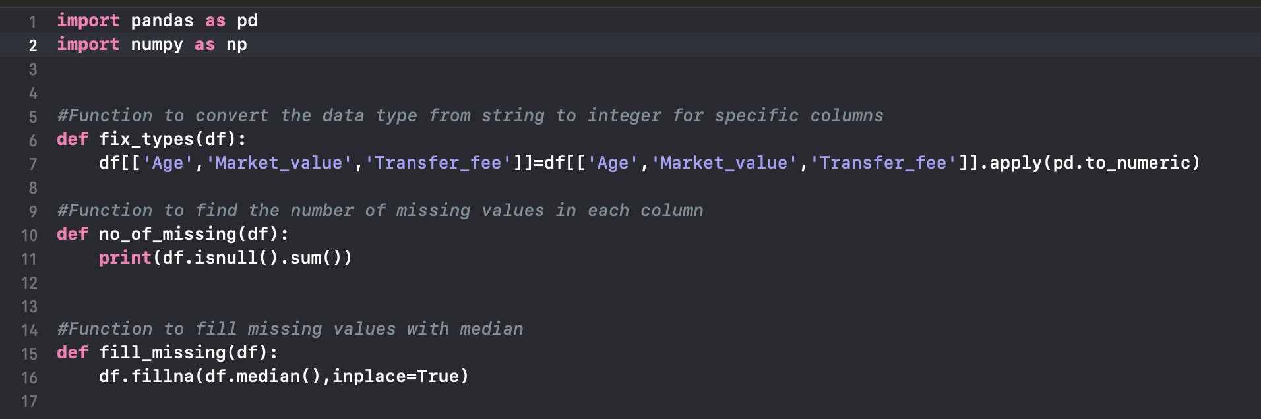
We have used the pandas library from python to clean the dataset.

Slide 7
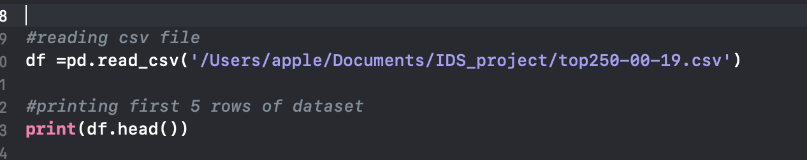
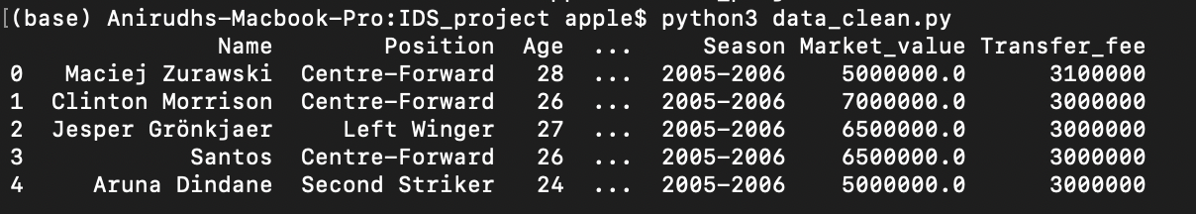
Output

Slide 8
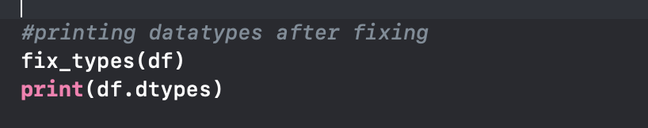
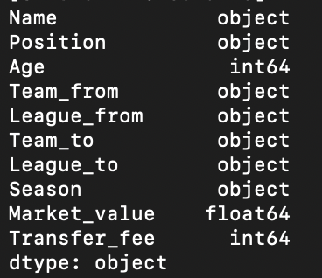
Output

Slide 9
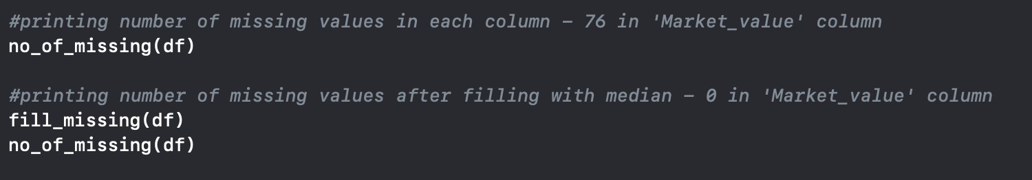
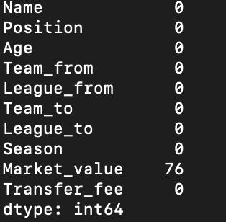
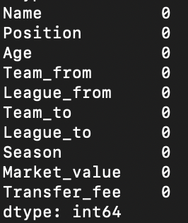
Output 1 Output 2

Slide 10
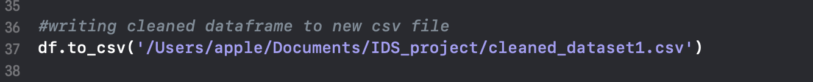

Slide 11
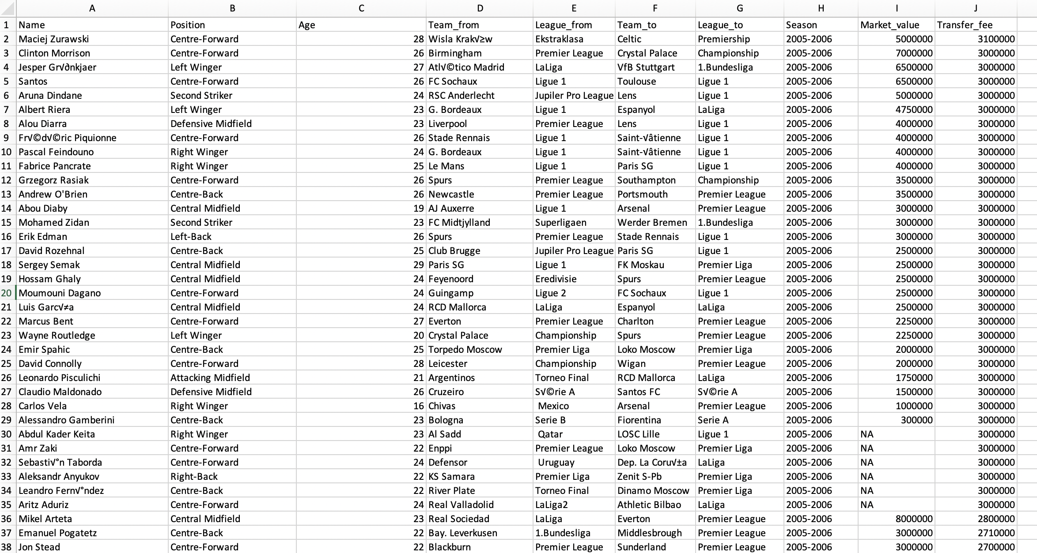
Before cleaning

Slide 12
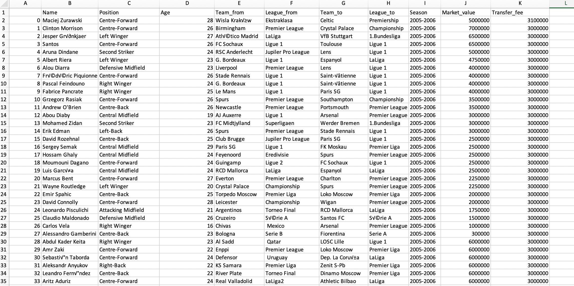
After cleaning

Slide 13
VISUALISING & ANALYSING THE DATA

Slide 14
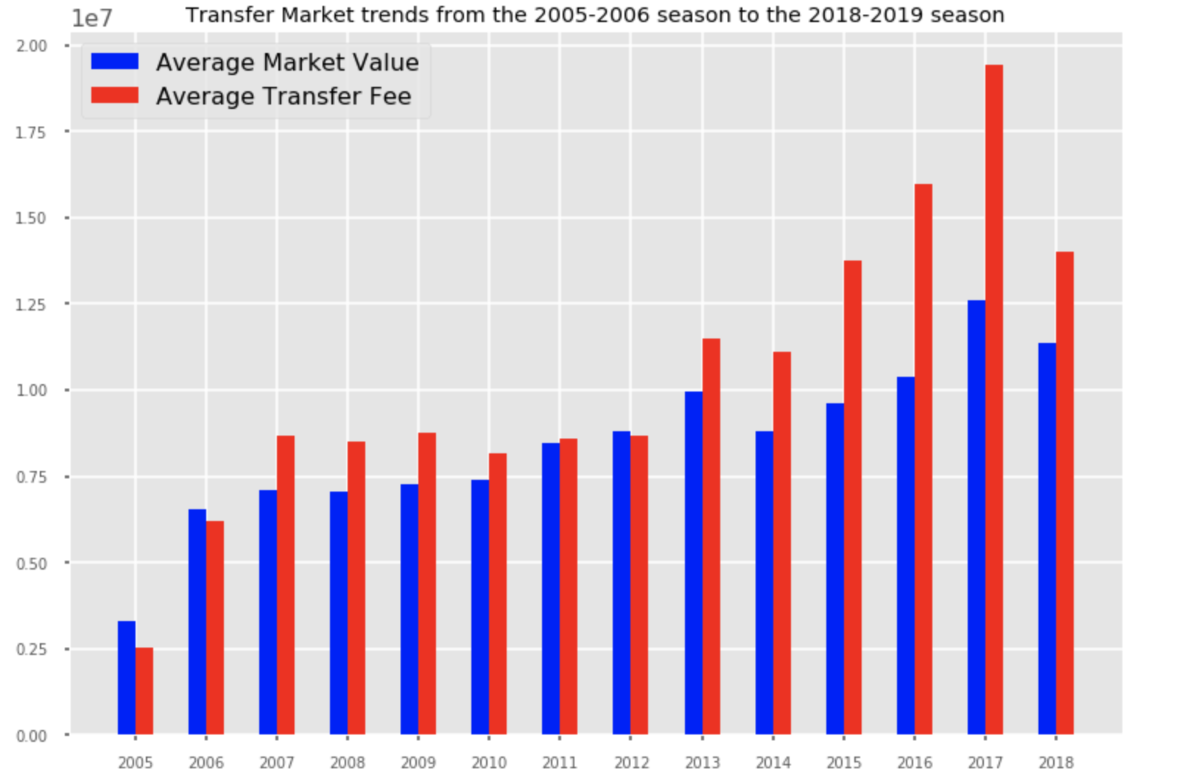
Bar plot showing Transfer market trends from 2005 to 2019

Slide 15
Effect of the most expensive transfer in football history

Slide 16
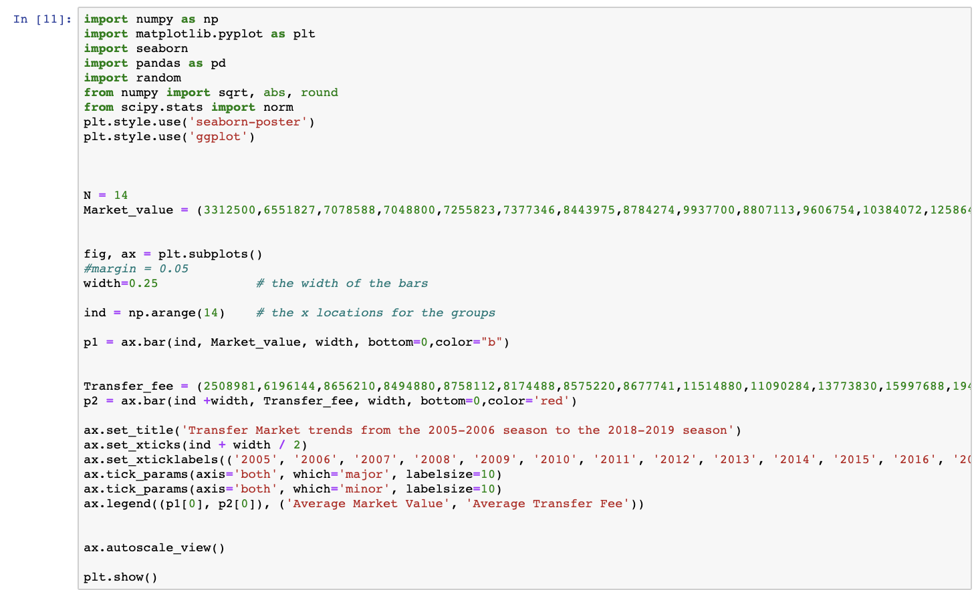
Bar plot code

Slide 17
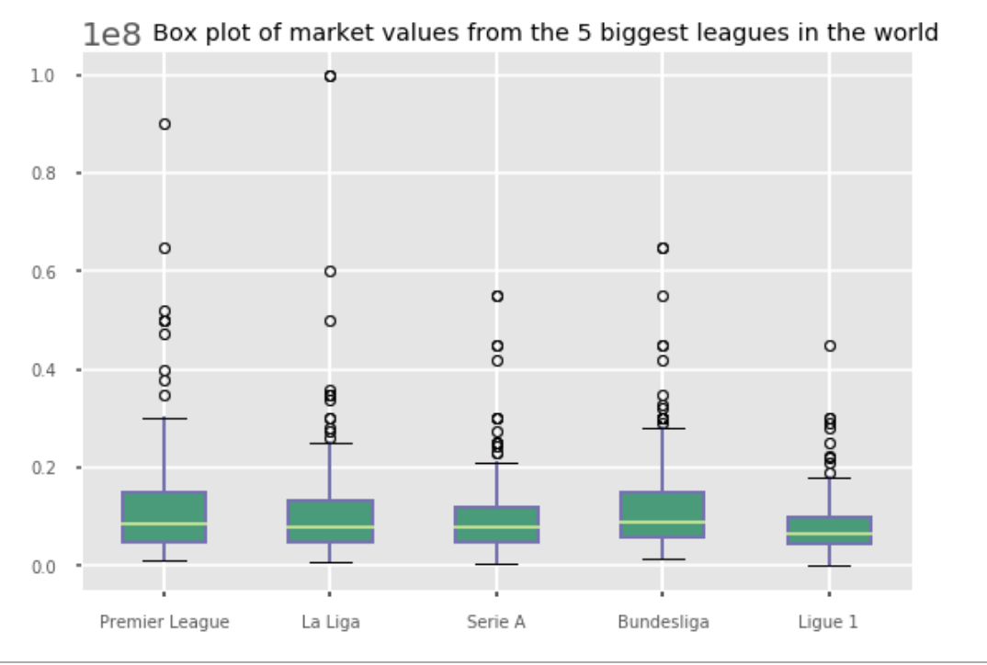
Box plot of Market values of the 5 biggest leagues in the world

Slide 18
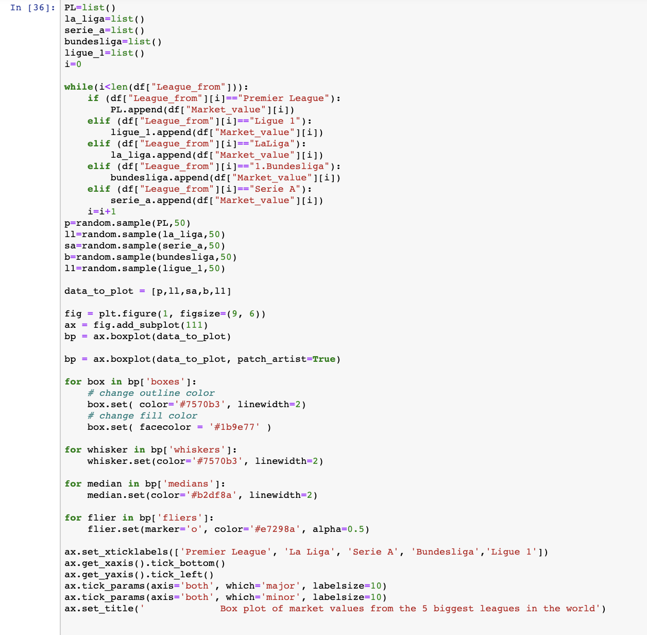
Box plot code

Slide 19
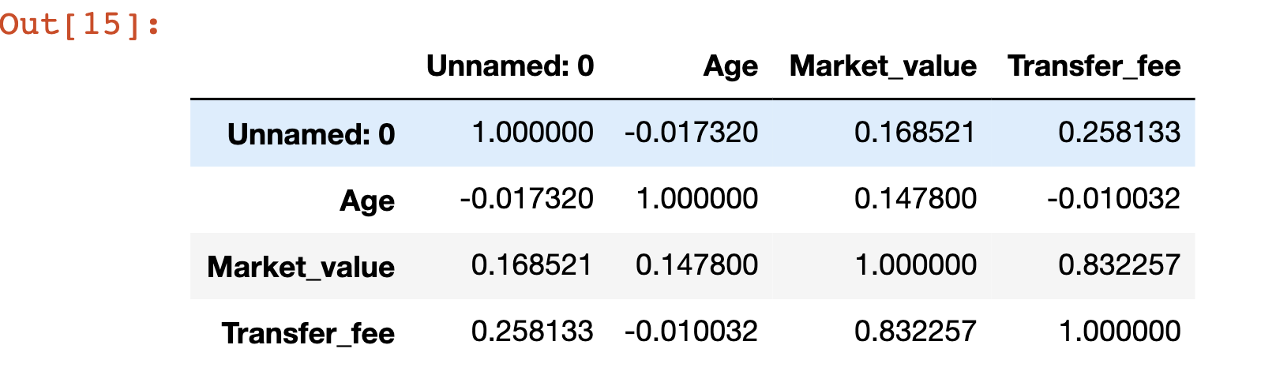
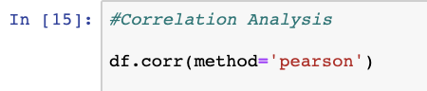
Correlational Analysis
Code
Output

Slide 20
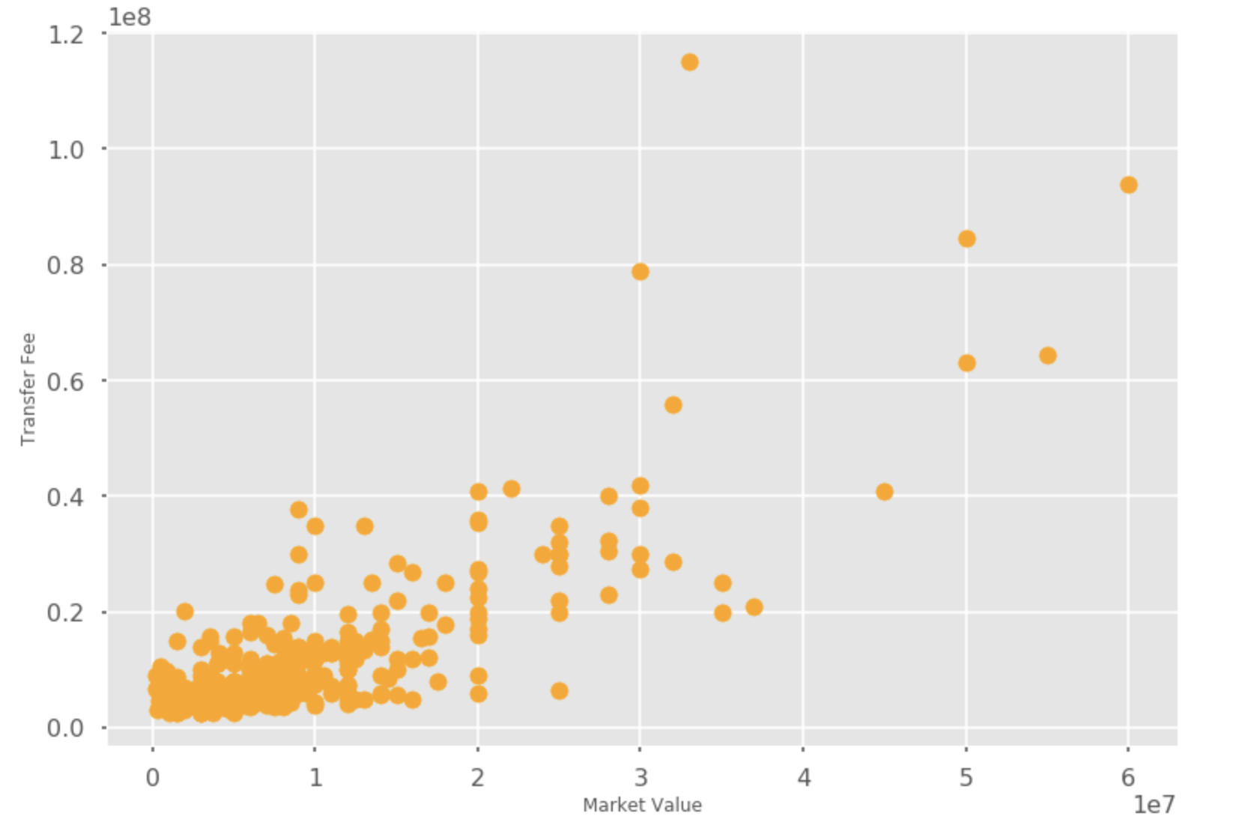
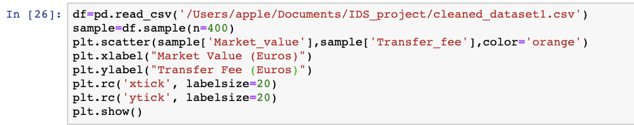
Market Value vs Transfer Fee
Code
Correlation Coefficient = 0.832257 (Strongly Linear)

Slide 21
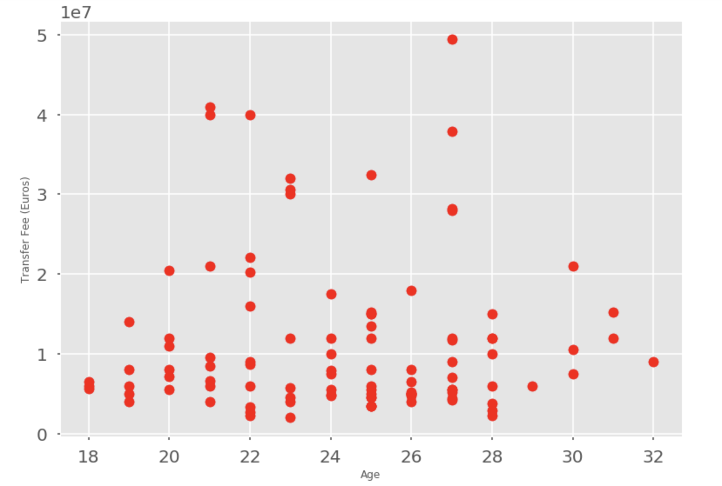
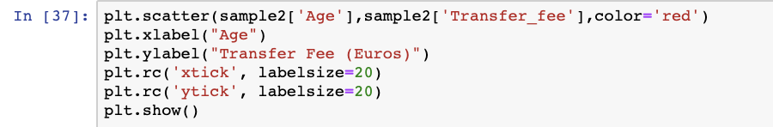
Age vs Transfer Fee
Code
Correlational Coefficient = -0.010032 (Non Linear)

Slide 22
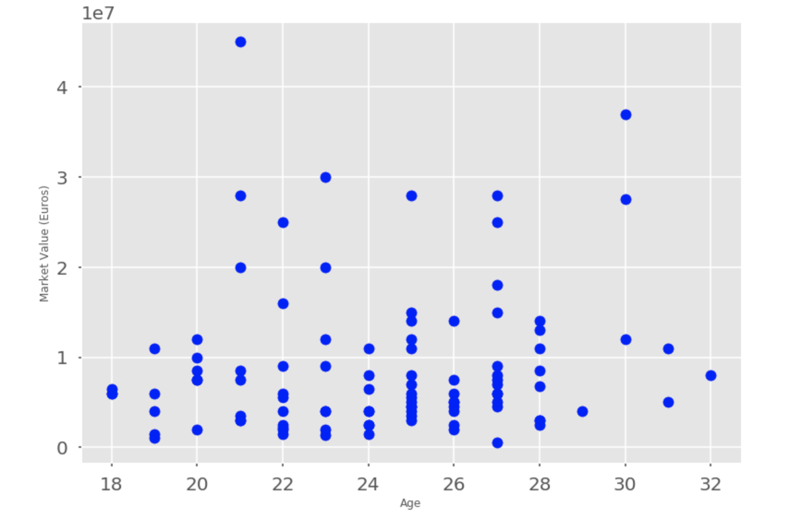
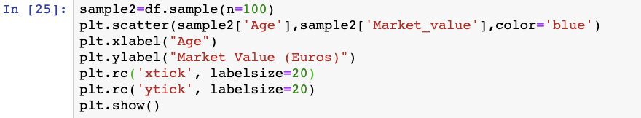
Age vs Market Value
Code
Correlational Coefficient = 0.147800 (Non Linear)

Slide 23
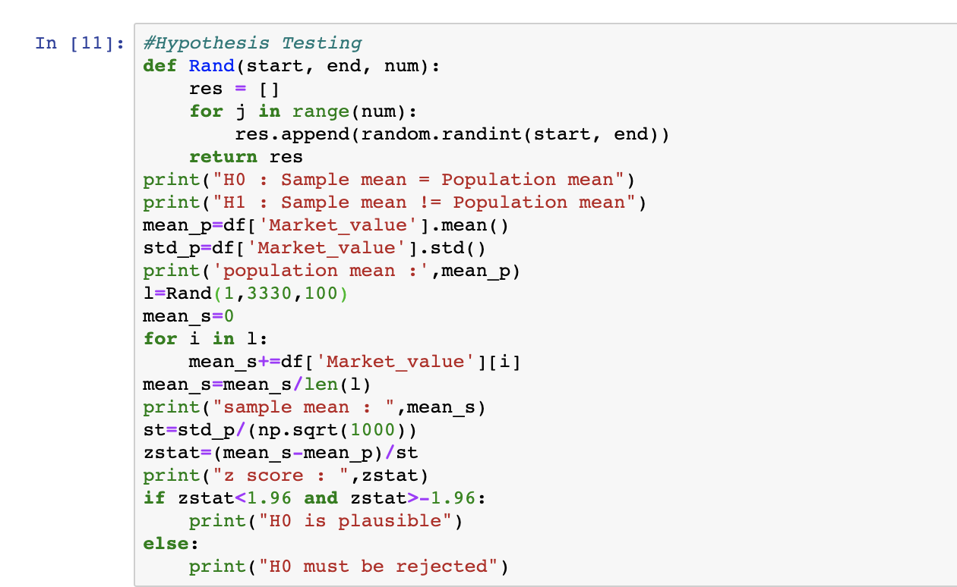
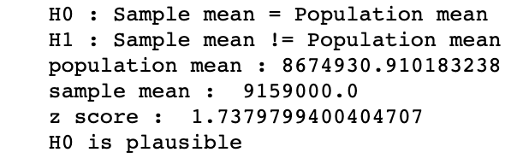
Hypothesis Testing
Output
Code

Slide 24
Inferences from Data Analysis
As evident from the grouped bar plot, the average Market Value and Transfer Fee is gradually increasing with each year. This may be due to a variety of reasons like inflation and increasing commercialization of the sport.
From the boxplot, we infer that out the 5 major leagues in the world , the Bundesliga (German League) and the English Premier League seem to have the most valuable players, as its median value is slightly higher than that of the other leagues.
The correlational analysis tell us that there is a strong linear relationship between the Market Value and Transfer Fee of the player. Most of the times, the transfer fee paid by the team is much more than the market value of the player. This is due to many reasons, one of them being competition from other teams to buy the same player.

Slide 25
Contd...
The relationship between Age of the player and Market Value, and Age of the player and Transfer fee, is non-linear. This can be easily explained.
The football players usually reach their peak potential between the ages of 25-30, which is when their Market Value and Transfer Fee are at a maximum. As they grow older and older their Market Value keeps dropping and so does the Transfer Fee.
Therefore the relationship is non linear.

Slide 26
TOOLS USED

Slide 27
We used python locally to carry out the data cleaning, and Jupyter Notebook to perform the data analysis.
The libraries we used were pandas ,numpy, random, matplotlib.pyplot, scipy and seaborn.

Slide 28
REFERENCES

Slide 29
Dataset - https://www.kaggle.com/vardan95ghazaryan/top-250-football-transfers-from-2000-to-2018
Using pandas and other libraries - https://www.geeksforgeeks.org/python-programming-language/

Slide 30
Thank You!

